Slide 1
Behavioral Monitoring Using Vocal Sentiment Analysis
Project ID : 003
Group Members Roll Number CGPA
Shehroz Waseem CS-18121 3.36
Sukaina Asad CS-18128 3.57
Abaad Murtaza CS-18131 3.63
Aiman Nisar CS-18140 3.18
Internal Advisor: Dr. Urooj Ainnudin

Slide 2
1.
Introduction

Slide 3
Introduction
Detecting sentiments is one of the most important marketing strategies in today’s world. we could personalize different things for an individual specifically to suit their interest.
Normally sentiment analysis is done through the text data, but the idea of our project is to extract sentiments from audio data to automate the time-consuming task of assessing human emotions.
We will extract not just fundamental prosody elements, but also many voice quality features, and combine them to determine two emotions i.e. angry and normal.

Slide 4
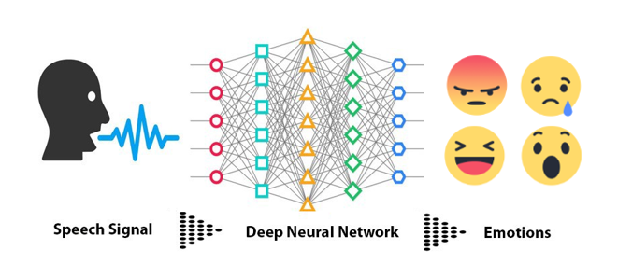
Introduction

Slide 5
2.
Project Background and Workflow

Slide 6
Project Background
Human emotions or behavior can be monitored using the text data i.e. their lexical features extracted from the text, facial expressions.
If one wants to predict emotions from real-time audio, following the lexical features would necessitate a transcript of the speech, which would necessitate an additional step of text extraction from speech.
The acoustic feature analysis can be done in real-time for which we only require the audio data to identify the emotions as Features extracted from human vocal data hold immense significance for sentiment analysis which gives insights into their emotional health.

Slide 7

Previous Work Overview
Module 1 | Part-1
Literature Review (Completed)
Conducted all the research required and utilized freely available English audio datasets for model training & testing.
Found out that Mel Frequency Cepstral Coefficients (MFCCs) were the best features to be extracted to identify human emotions.
At the end of March 2022, we were successful in building a CNN model that was giving predictions of human emotions through their voice in “English Language” with 87% accuracy.
Module 1 | Part-2
Data Collection and Organization (Completed)
Module 2 | Part-1
Feature Extraction (Completed)
Module 2 | Part-2
Model Development (In Progress)

Slide 8
Project WorkFlow
New Dataset Collection
Application Development
Integration & Testing
1
3
5
2
4
6
Training & Testing of Model
API Development
Documentation

Slide 9
3.
Project Overview (Model Development)

Slide 10
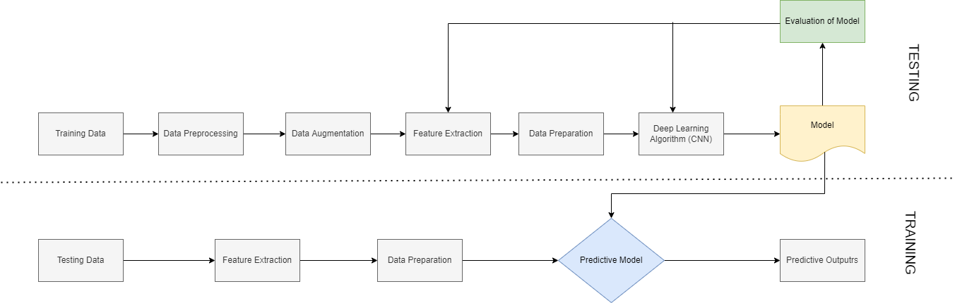
Flow Chart
TRAINING
TESTING

Slide 11

Data Collection and Peprocessing
Previously, we had utilized 4 different publically available audio datasets to predict seven basic human emotions.
We then shifted our approach of sentiment analysis to Urdu Language. Whose datasets were not easily available. We created the dataset in Urdu from scratch.
The dataset included the audio files of two males and two females, speaking different utterances in anger and normal tone. Each individual recorded a total of 250 audios (4 sec each), which includes both emotions i.e. 125 audios for each emotion.
Dataset consists of 1000 audio files.
Normal Emotion Audios
Anger Emotion Audios

Slide 12
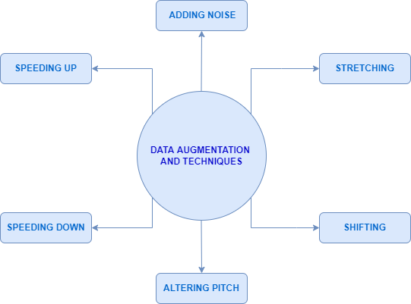
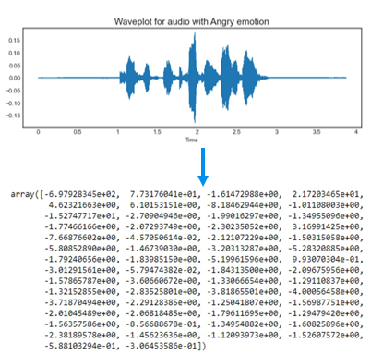
Data Augmentation
Feature Extraction
Data augmentation is the process of creating further synthetic data samples from our initial training set by adding tiny perturbations.
For The Mel Frequency Cepstral Coefficients (MFCCs) of a signal are a small set of features which concisely describe the overall shape of a spectral envelope.

Slide 13
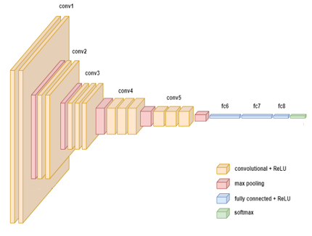
Model Development
Convolutional Neural Networks (CNNs) are a type of deep learning model that had made a lot of success in Speech Data Processing.
A typical CNN is made up of multiple convolutional layers, each of which is followed by a pooling layer and fully connected layers.
The input from the preceding steps is a standardized 1D-vector (array) which is then passed to the convolution layer and further to pooling layers.
The fully connected layer, which is essentially a regular MLP, is the final building block of CNNs. The output from the CNN is a 2D-vector (array).

Slide 14
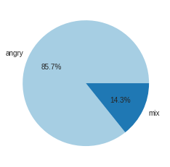
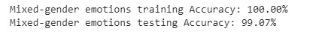
Training and Testing
This complete dataset is divided into two subsets for training and testing of our model.
The model will be trained for 80% of the data and the rest 20% is used for the testing phase for our model.
The accuracy of both sets is as follows:
normal
Results for an audio with anger emotion

Slide 15
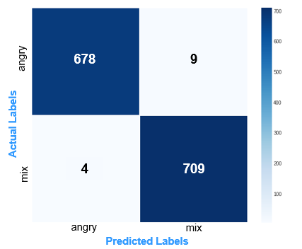
Results Analysis

Slide 16
4.
Project Overview (Application Development)

Slide 17
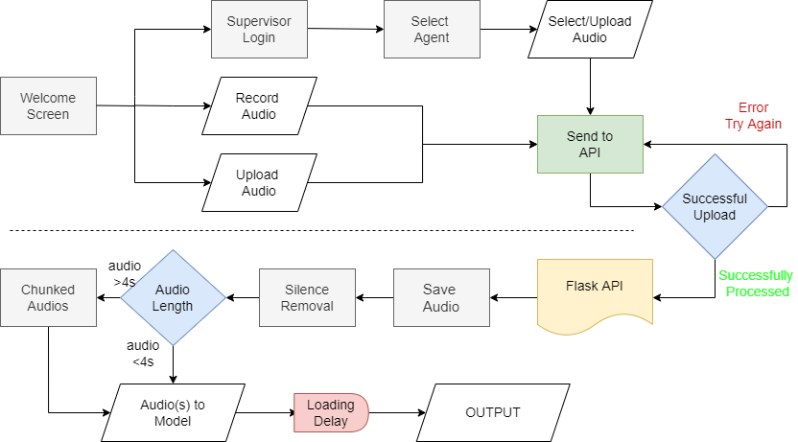
App Flow Chart

Slide 18
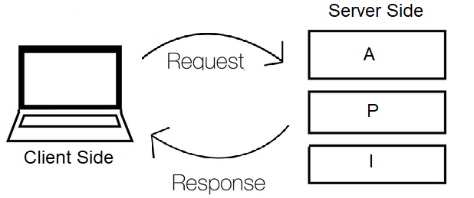
Flask – API Development
Flask is a popular micro framework for building web applications. We used flask to create an API endpoint so our front end can send a request to our model for a response.
We created a POST endpoint in which it expects an audio file as the body of the request and returns an array of emotions as a response via GET request, predicted by the model from that audio.
When the API receives the audio file some pre-processing is done in which it removes the silenced region from the audio and if the audio is large it divides the
audio into chunks and perform the analysis on each audio.
Flask provides us with a jsonify function that allows us
to convert the response to JSON format.

Slide 19
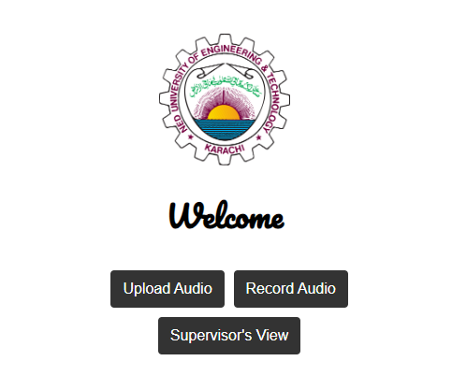
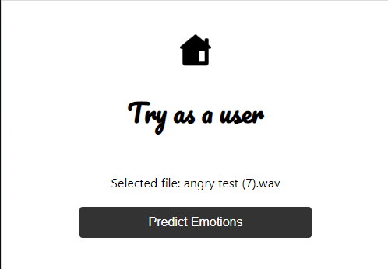
User Interface – Front End Development
Reactjs has been used to develop the front end as SWA and for styling, CSS has been used.
The app features three different ways in which the user can send the request/audio to the end point for analysis.
The first way is to try the application as a test user where the user has the option to upload the audio.
Upon a successful request a pie chart will be generated containing the response of that uploaded audio featuring the predicted emotions.

Slide 20
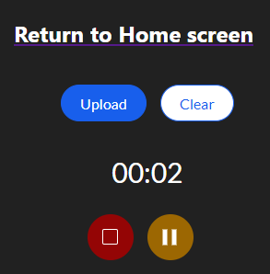
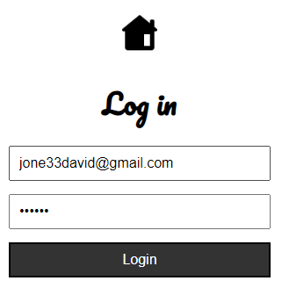
User Interface – Live Audio Recording
The second option is to use the In-app built-in audio recorder where the user can record their audio and upon stopping the audio it will be ready to upload for the prediction.
The third option is for supervisors in which they will log in with the given credentials. For authentication, we have used FirebaseAuth.
Upon successful login the supervisor will have a list of agents working under them and for each agent, their audios will be fetched from the database

Slide 21
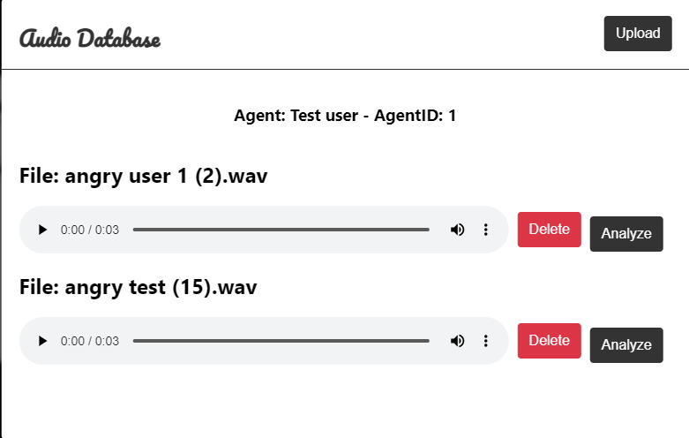
User Interface – Supervisor View
The admin panel is fully functional for a supervisor, who can delete the agent’s data from the database or can upload new data for the agent from his/her system
Firebase Realtime database is used to save the information about the agent (name and id).
For every agent the audios are fetched from the firestore database which is a cloud storage option provided by firebase

Slide 22
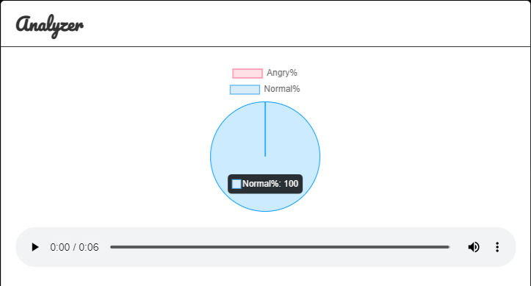
User Interface – Result Preview
Upon successful submission of the file sentiment analysis will be performed on the provided audio.
The prediction is categorized into angry and mixed emotion classes.
The pie chart will feature the predictions in percentage value along with a preview of the submitted audio.

Slide 23
5.
Milestone Summary

Slide 24
Achieved Milestone
MILESTONE 2
Model Development
MILESTONE 4
Integration & Testing
OCT 21
NOV 21
DEC 21
JAN 22
FEB 22
MAR 22
APR 22
MAY 22
JUN 22
JUL 22
AUG 22
SEP 22
MILESTONE 3
Application Development
MILESTONE 5
Documentation
MILESTONE 1
Literature Review

Slide 25




Task Division
Aiman Nisar 1. Data Collection
2. EDA
3. Data Augmentation
4. Frontend Development
5. Integration
6. Documentation
Sukaina Asad 1. Data Collection
2. Feature Extraction
3. Data Augmentation
4. UI & Database (Firebase)
5. Testing
6. Documentation
Shehroz Waseem 1. Data Collection
2. Model R&D
3. Data Preparation
4. Result Analysis
5. API Development
6. Integration
7. Documentation
Abaad Murtaza 1. Data Collection
2. Model R&D
3. Hyper parameter Tuning
4. Result Analysis
5. API Development
6. Testing
7. Documentation

Slide 26
Challenges Faced
Initially, we ran our model using the MLP classifier with the RAVDESS DATASET and discovered that while we had greater accuracy, our predictions were not up to par. We discovered that the dataset was insufficient, and that the model prediction performance was also lacking.
We expanded our dataset, collecting four additional datasets in which we encountered class imbalance issues, in which all emotions were not equally represented in the sample. We updated the dataset to address this problem.
We investigated whether CNN, rather than MLP, could be a better approach because to its unique network structure, which includes convolution and pooling layers, and then switched to CNN for prediction.

Slide 27
Challenges Faced
Our previous dataset consisted of audios in English language of various actors in various accents. We changed our dataset to Urdu language so the app can be used locally.
Our dataset compromised of audios of long lengths, which included emotions of all types. So the audios were broken into chunks of 4 seconds and prediction is performed on these chunks by extracting MFCCs from them. Accuracy was improved due to this.

Slide 28
6.
Future Enhancement

Slide 29

Future Enhancement
The model can be improved further by:
Training & testing on large dataset.
Prediction of more than two emotions (relevant to the application domain).
Shorten the time it takes to produce results.
Improving UI and extending features for multiple supervisors to access the application.
Automating the entire sentiment monitoring application for supervisors so that they don’t have to analyze each audio of each agent they supervise.
Predict on the complete audio file rather than breaking it up into chunks to save time.

Slide 30
Thank You

